Slide 1







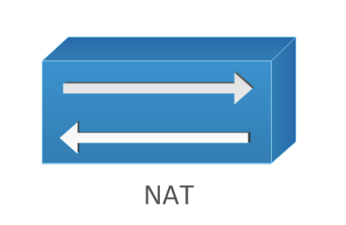
Leased Line
DMZ
TAS
DB Cluster
App Cluster
Ngnix cluster
Ngnix cluster
Spring Cloud Gateway
Oracle
DMS
Apigee Hybrid
Mongo
Kafka
Spring Cloud
Microservices
Redis Cache
jBPM
Elastic search
Drools
API Calls Via Internet
Web Portal URL Via Internet
API Calls Via Leased Line
Web Portal URL Via Leased Line

